Slide 1
Visualizing and Clustering Climate Change Milestone 3
Lei Zhong
Hantian Zhang
Jian Zhang

Slide 2
Data Model
All the data separated by years.
a table consists of rows and column. Rows are sorted by station id, date, code and number.
We use Hadoop MapReduce to do our tasks.
We use multiple keys: station id, year, month.
Our programming model is Hadoop MapReduce and Hadoop HDFS.
We use boto's interface to upload the 300 years data to the S3 system and each intermediate results would all be stored in S3.

Slide 3
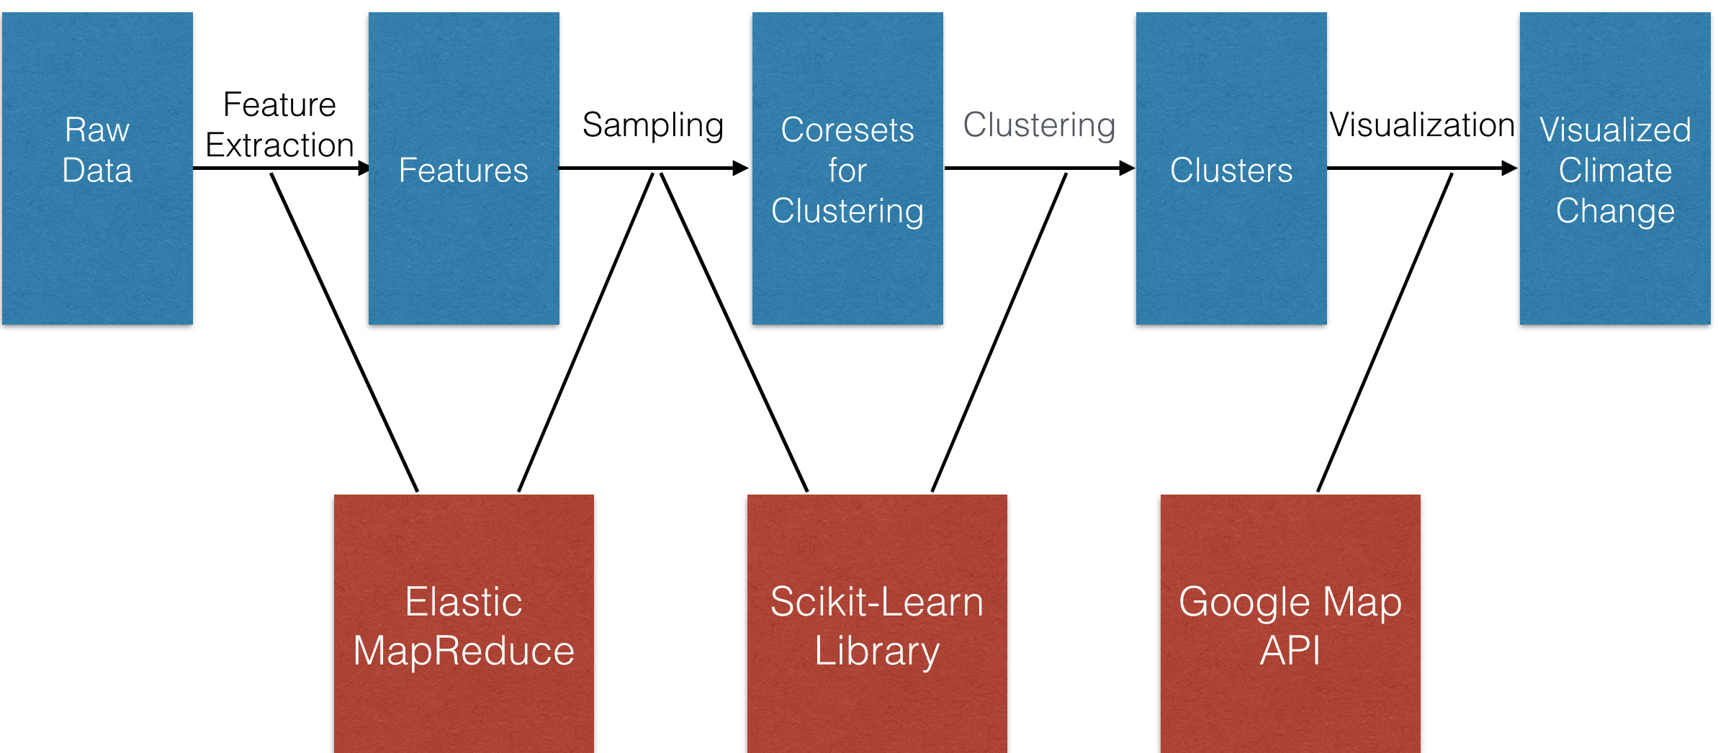
System Atchitecture
Updates to the previous milestone:
Uses Amazon EMR to extract features from ~100G raw data
~3M data points in total, unable to run k-means on all data
Uses coreset sampling for k-means clustering

Slide 4
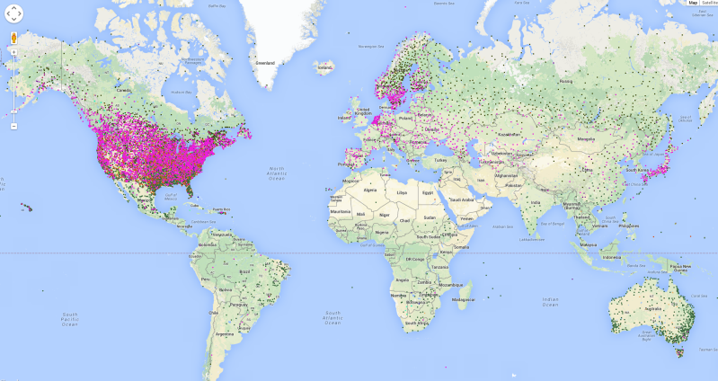
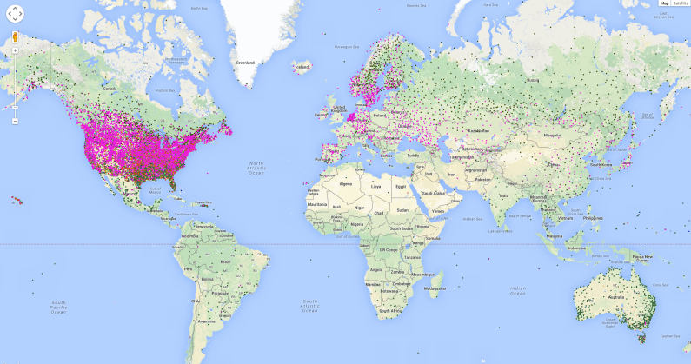
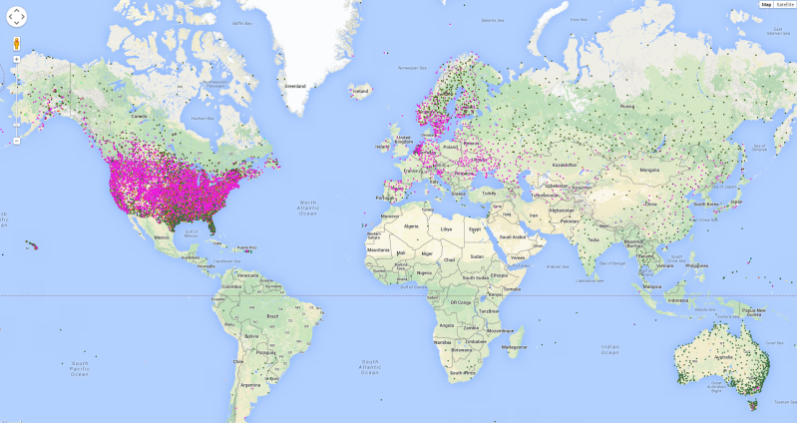
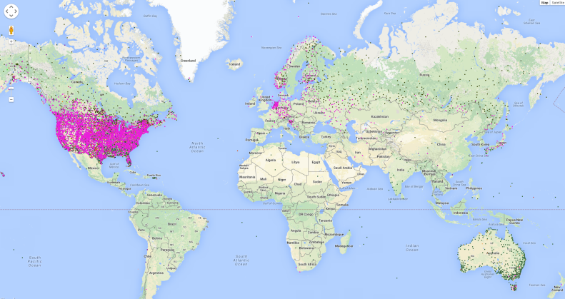
Analysis on Results
1983
1993
2003
2013
Analysis on Results
Only 3 big clusters
Lack of preserved points in areas other than the US
3.Big clusters covering the same areas

Slide 5
Analysis on Results (Cont.)
2003
2013
Possible Solutions
Only 3 big clusters
Investigate distribution of weights for coreset points
Possibly update our sampling strategy
Lack of preserved points in areas other than the US
Adjust threshold of number of missing features for invalid data elimination

Slide 6
Thanks!

